Slide 1
Module 7 Guidance Notes C++ Strings, C Characters & Strings, Recursion
ENGG1340 Computer Programming II

Slide 2
Before We Start
We will deal with both C and C++ in this module, so please note the specific compiler settings when C is discussed.
C++: We will be using the C++ 11 standard, so make sure that your compiler option is set appropriately. We suggest to use the following command to compile your C++ program:
g++ -pedantic-errors -std=c++11 your_program.cpp
C: We will be using the C11 standard, so make sure that your compiler option is set appropriately. We suggest to to use the following command to compile your C++ program: gcc -pedantic-errors -std=c11 your_program.c
The C compiler will be used in Part II when we talk about C-Strings. We will have more details on the compilation environment then.

Slide 3
How to Use this Guidance Notes
This guidance notes aim to lead you through the learning of the C/C++ materials. It also defines the scope of this course, i.e., what we expect you should know for the purpose of this course. (and which should not limit what you should know about C/C++ programming.)
Pages marked with “Reference Only” means that they are not in the scope of assessment for this course.
The corresponding textbook chapters that we expect you to read will also be given. The textbook may contain more details and information than we have here in this notes, and these extra textbook materials are considered references only.

Slide 4
How to Use this Guidance Notes
We suggest you to copy the code segments in this notes to the coding environment and try run the program yourself.
Also, try make change to the code, then observe the output and deduce the behavior of the code. This way of playing around with the code can help give you a better understanding of the programming language.

Slide 5
References
cplusplus.com tutorial
Strings
Textbook Chapters
C++: How to program (9th edition) Electronic version available from HKU library
Ch. 6.20-22 (on recursion)
Ch. 21.1-9 (on C++ strings)

Slide 6
Topics
Part I: Strings (C++)
Part II: Characters and Strings in C
Part III: Recursion (C++)

Slide 7
Strings
Part I
Note that we will be using C++ in Part I

Slide 8
What are we going to learn?
The string class as string representations
String concatenation
String comparison
String I/O
Member functions of the string class for string manipulation, e.g.,
string::length()
string::empty()
string::substr()
string::find()
string::rfind()
…

Slide 9
The Class String
C++ standard library provides a class (i.e., programmer defined data type) named string for more convenient handling of strings.
We need to include the header file string to use the class string:
A string object can be declared using the class name string and initialized with a C-string or another string object:
#include <string>
char a[80] = "Hello"; // a C-string
string msg1 = a; // initialized with a C-string
string msg2 = "World"; // initialized with a string literal
string msg3 = msg1; // initialized with a string object

Slide 10
String Assignment
The string class has its own end-of-string representation, for which we do not need to handle.
Unlike C-string, we can initialize or change a string object using an assignment statement after its declaration:
Recall that in C-string, we need the null character ’\0’ to indicate end of string
char a[80] = "Hello";
string msg1, msg2, msg3;
msg1 = a; // initialized with a C-string
msg2 = "World"; // initialized with a string literal
msg3 = msg1; // initialized with a string object

Slide 11
String: Subscript Operator
We may also access individual character using the subscript operator []:
string msg = "Hello World!";
msg[11] = '?';
cout << msg << endl;
Hello World?
Screen output

Slide 12
String Concatenation
Two strings can be concatenated to form a longer string using the binary operator +
Note that at least one of the operands of + must be a string object.
I love cats
string msg1 = "I love ";
string msg2 = "cats";
string msg3 = msg1 + msg2;
string msg4 = msg1 + "dogs";
string msg5 = "I hate " + msg2 + " and dogs";
I love dogs
I hate cats and dogs
Here, both operands are string literals (i.e., constants)
string msg = "I love " + "dinosaurs";
✗

Slide 13
String Comparison
Strings can be compared lexicographically (dictionary order) using relational (>, <, >=, <=) and equality (==, !=) operators. The comparison is carried out in a character by character manner.
Note: at least one of the operands need to be a string object
string msg1 = "Apple", msg2 = "apple";
string msg3 = "apples", msg4 = "orange";
bool c1 = msg1 == msg2;
bool c2 = msg1 < msg2;
bool c3 = msg2 < msg3;
bool c4 = msg3 != msg4;
bool c5 = msg4 > msg3;
c1
?
c2
?
c3
?
c4
?
c5
?
false
true
true
true
true

Slide 14
Example Programs
A palindrome is a sequence of characters which reads the same forward or backward, e.g., “radar”, “level”, “kayak”, “madam”, “Was it a car or a cat I saw”. Write a program to check if a string is a palindrome. You may hard-code the string in the program for the time being. Hint: compare corresponding characters in the string
Write a program to reverse a string. E.g., the reverse of "apple" is "elppa". You may hard-code the string in the program for the time being. Hint: use concatenation to construct the resulting string in reverse
palindrome.cpp
reverse_string.cpp

Slide 15
I/O with String Objects
Both cout and cin support string objects.
The insertion operator << and extraction operator >> work the same for string objects as for other basic data types
Note that
The extraction operator >> ignores whitespace and stops reading when it encounters more whitespace
The word received by a string object will therefore have any leading and trailing whitespace deleted
Cannot read in a line or string that contains one or more blanks
string msg;
cin >> msg;
cout << msg;

Slide 16
I/O with String Objects
Example
Please input a sentence:
I love dogs
Word 1 = "I"
Word 2 = "love"
Word 3 = "dogs"
#include <iostream>
#include <string>
using namespace std;
int main()
{
string word1, word2, word3;
cout << "Please input a sentence: " << endl;
cin >> word1 >> word2 >> word3;
cout << "Word 1 = \"" << word1 << "\"\n"
<< "Word 2 = \"" << word2 << "\"\n"
<< "Word 3 = \"" << word3 << "\"\n";
return 0;
}
Screen output
Use \" for a " character in a string
string_io.cpp
How do we read in an entire line including spaces from the input then?

Slide 17
Reading a Line from Input
We use the library function getline() to read in a line from the standard input and store the line in a string:
string s;
cout << "Please input a sentence: " << endl;
getline(cin, s);
cout << "s = \"" << s << "\"\n";
string_getline.cpp
Please input a sentence:
I love dogs
s = "I love dogs"
Screen outputs

Slide 18
Reading a Line from Input
The function getline() can be used to read in a line from the current position until a delimitation character is encountered
string s;
cout << "Input 2 comma-separated phrases: " << endl;
getline(cin, s, ',');
cout << "1st phrase = \"" << s << "\"\n";
string_getline.cpp
Input 2 comma-separated phrases:
Stay hungry, stay foolish
1st phrase = "Stay hungry"
As you can see, without providing the third argument (‘,’ in this case), the default delimitation character for the getline function is the newline character ‘\n’.
Screen outputs

Slide 19
Member Functions
The class string has a number of member functions which facilitate string manipulation, which includes
string::length() – returns length of the string
string::empty() – returns whether the string is empty
string::substr() – returns a substring
string::find() – finds the first occurrence of content in the string
string::rfind() – finds the last occurrence of content in the string
string::insert() – inserts content into the string
string::erase() – erases characters from the string
string::replace() – replaces part of the string
More member functions can be found at http://www.cplusplus.com/reference/string/string, but you are expected to be get familiar with the above functions only for this course.

Slide 20
string::length()
Returns the number of characters in a string object
string s = "Stay hungry, stay foolish";
int n = s.length();
cout << "s has " << n << " characters. " << endl;
s has 25 characters.
Note we use . to invoke the member function of the string object s.
Screen outputs
Exercise: Modify the reverse string and palindrome programs on 14. Example Programs to work on any input words.

Slide 21
string::empty()
Returns true if a string object is empty; false otherwise
string s;
if (s.empty())
cout << "s is empty." << endl;
else
cout << "s has " << s.length() << " characters.\n";
s is empty.
What if s = " "?
Is this an empty string?
Screen outputs
No, this is a string with a space character, and its length is 1.

Slide 22
string::erase()
Erase n characters starting at a specific position pos from the current string
Note that the string will be modified
[0] | [1] | [2] | [3] | [4] | [5] | [6] | [7] | [8] | [9] | [10] | [11] | [12] | [13] | [14] | [15] | [16] | [17] | [18] | [19] | [20] | [21] | [22] | [23] | [24]
S | t | a | y |  | h | u | n | g | r | y | , |  | s | t | a | y |  | f | o | o | l | i | s | h
text
text.erase(11, 6)
Resulting string: "Stay hungry foolish"
pos
n

Slide 23
Example
string firstName = "Alan";
string name = firstName + " Turing";
string str1 = "It is sunny. ";
string str2 = "";
string str3 = "C++ programming.";
string str4 = firstName + " is taking " + str3;
cout << str1.empty() << endl;
cout << str2.empty() << endl;
str3.erase(11,4);
cout << str3 << endl;
cout << firstName.length() << endl;
cout << name.length() << endl;
cout << str4 << endl;
0
1
C++ program.
4
11
Alan is taking C++ programming.
string_op.cpp
Screen outputs

Slide 24
string::substr()
Returns a substring of the current string object starting at the character position pos and having a length of n characters
[0] | [1] | [2] | [3] | [4] | [5] | [6] | [7] | [8] | [9] | [10] | [11] | [12] | [13] | [14] | [15] | [16] | [17] | [18] | [19] | [20] | [21] | [22] | [23] | [24]
S | t | a | y |  | h | u | n | g | r | y | , |  | s | t | a | y |  | f | o | o | l | i | s | h
text
text.substr(0, 11)
text.substr(18)
pos
n
The second parameter is omitted, this extracts a substring till the end of string.

Slide 25
string::substr()
Example
string s;
string str;
s = "It is cloudy and warm.";
cout << s.substr(0, 5) << endl;
cout << s.substr(6, 6) << endl;
cout << s.substr(6, 16) << endl;
cout << s.substr(17, 10) << endl;
cout << s.substr(3, 6) << endl;
str = s.substr(0, 8);
cout << str << endl;
str = s.substr(2, 10);
cout << str << endl;
Screen outputs
It is
cloudy
cloudy and warm.
warm.
is clo
It is cl
is cloudy
substring.cpp

Slide 26
string::find()
Searches a string object for a given string str, and returns the position of the first occurrence
When pos is specified the search only includes characters at or after position pos, ignoring any possible occurrences in previous locations
If there is no occurrence of str, the constant value string::npos (i.e., –1) will be returned
find(str)
find(str, pos)

Slide 27
string::find()
This example shows that the search is case-sensitive
Example
string s = "Outside it is cloudy and warm.";
string t = "cloudy";
cout << s.find("is") << endl;
cout << s.find('s') << endl;
cout << s.find(t) << endl;
cout << s.find('i', 6) << endl;
cout << s.find('o') << endl;
if (s.find("the") == -1)
cout << "not found" << endl;
if (s.find("the") == string::npos)
cout << "not found" << endl;
Screen outputs
11
3
14
8
16
not found
not found
string_find.cpp

Slide 28
string::rfind()
Searches the current string object for the content specified in str, and returns the position of the last occurrence
When pos is specified the search only includes characters at or before position pos, ignoring any possible occurrences in later locations
If there is no occurrence of str, the constant value string::npos (i.e., –1) will be returned
rfind(str)
This is essentially to search in the reverse direction from the end of the string
rfind(str, pos)

Slide 29
string::rfind()
Example
string s = "Outside it is cloudy and warm.";
string t = "cloudy";
cout << s.rfind("is") << endl;
cout << s.rfind('s') << endl;
cout << s.rfind(t) << endl;
cout << s.rfind('i', 6) << endl;
cout << s.rfind('o') << endl;
if (s.rfind("the") == -1)
cout << "not found" << endl;
if (s.rfind("the") == string::npos)
cout << "not found" << endl;
Screen outputs
11
12
14
4
16
not found
not found
string_rfind.cpp

Slide 30
Programming Exercises
Write a program that finds the positions of ALL occurrences of a substring in a string, starting from the first occurrence to the last occurrence.
Write a program that finds the positions of ALL occurrences of a substring in a string, starting from the last occurrence to the first occurrence.

Slide 31
string::insert()
Inserts the content specified in str at position pos of the current string
[0] | [1] | [2] | [3] | [4] | [5] | [6] | [7] | [8] | [9] | [10]
S | t | a | y |  | h | u | n | g | r | y
text
v | e | r | y
text.insert(5, "very ")
pos
str
Resulting string: "Stay very hungry"

Slide 32
string::replace()
Replaces n characters starting at position pos from the current string by the content specified in str
[0] | [1] | [2] | [3] | [4] | [5] | [6] | [7] | [8] | [9] | [10]
S | t | a | y |  | h | u | n | g | r | y
text
f | u | n | n
text.replace(5, 5, "funn ")
pos
n
str
Resulting string: "Stay funny"

Slide 33
Example
string s1 = "Cloudy and warm.";
string s2 = "Angel is taking programming.";
string t1 = " very";
string t2 = "Nelson";
cout << s1.insert(10, t1) << endl;
cout << s2.replace(0, 5, t2) << endl;
Cloudy and very warm.
Nelson is taking programming.
string_insert_replace.cpp
Screen outputs

Slide 34
The Hangman Game
Tutorial Problems - Strings

Slide 35
The Hangman Game
You are going to implement the Hangman game in this task.
Your program will generate a random word for a user to guess.
You program should display dashes for unrevealed letters for the word
The player will guess a letter in each round
If the letter appears in the word, display all occurrences of the letter in the word
Otherwise add one stroke to the hangman picture
The game ends when
Either the player wins by successfully guessing the complete word
Or the player loses when the hangman picture is shown in full

Slide 36
The Hangman Game
Sample game play (suppose the word is “engineering”):
Word: -----------
|
Guess a letter: a
Word: -----------
|
O
Guess a letter: e
Word: e----ee----
|
O
Guess a letter: o
Word: e----ee----
|
O
|
Guess a letter: i
Word: e--i-ee-i--
|
O
|
Guess a letter: u
Word: e--i-ee-i--
|
O
/|
Guess a letter: s
Word: e--i-ee-i--
|
O
/|\
Guess a letter: t
Word: e--i-ee-i--
|
O
/|\
/
Guess a letter: g

Slide 37
The Hangman Game
Sample game play (suppose the word is “engineering”):
Word: e-gi-ee-i-g
|
O
/|\
/
Guess a letter: n
Word: enginee-ing
|
O
/|\
/
Guess a letter: r
Word: engineering
|
O
/|\
/
You win!
winning case
Word: enginee-ing
|
O
/|\
/
Guess a letter: b
Word: engineering
|
O
/|\
/ \
You lose!
losing case
hangman.cpp provides the completed version of this tutorial problem. You may compile and run it to see the expected results first.

Slide 38
Task 1: Generate a random word
Open hangman_incomplete.cpp.
The word list to be guessed by the player is stored in an array of strings:
Generate a random number to randomly select one of the words in the word list as the guessing word.
string wordlist[10] = { "engineering", "hangman", "brainstorm", "random",
"envelope", "interface", "iceberg", "humour", "lemon", "commander"};
// TODO: Task 1: fill in the index to choose a random word from the word list
string word = wordlist[ ];
Complete this in the main() function
Store the guessing word

Slide 39
Task 2: Initialize the answer
Next, we need to initialize the answer string so that it contains only the hyphen '-' character to hide all letters of the guessing word. E.g., if the guessing word is "random", the answer is initialized to "------".
Task 2 is to complete the function init_answer():
// return a string containing a sequence of '-' with specified length
string init_answer( int length )
{
string g;
// TODO: Task 2: compose the string g so that its length = length and
// it only contains the letter '-'
return g;
}
Complete the task here. Idea: Append the letter '-' to g until g is of the required length

Slide 40
Task 3: Call init_answer()
In the main function, we will need to call init_answer() and store the resulting string in the variable answer.
// initialize the answer string
// TODO: Task 3: call init_answer and assign it to answer
string answer =
Complete this by calling the function init_answer().
What is the parameter that needs to be passed? What should be the length of the string answer?

Slide 41
Game Logic
Now take a look at the while loop in the main() function.
The game logic is as follows:
While the game is not ended
Show the current answer and the hangman figure
Determine whether it is end of game. There are two ways to end a game:
the player guessed the word. In this case, all the letters in the string answer should be revealed.
the player loses because he made too many wrong guesses.
If it is the end of game, print the appropriate message and quit
Otherwise, ask the user to make a guess.
If the guess is correct, update the answer by unmasking the correct letters
Otherwise, update the counter for recording the number of wrong guesses

Slide 42
Task 4: Game Logic
Let's complete the game logic in the main function().
while (!endgame)
{
cout << "Word: " << answer << endl;
show_hangman( num_wrong_guess );
// determine if it's an end game
// TODO: Task 4: fill in the end-of-game conditions
if ( )
{
cout << "You win!" << endl;
endgame = true;
}
else if ( )
{
cout << "You lose!" << endl;
endgame = true;
}
else {
…
}
}
Fill in the end-of-game conditions here

Slide 43
After guessing a letter
After the player has guessed a letter, we need to check if the letter is in the guessing word.
while (!endgame)
{
…
else {
cout << "Guess a letter: ";
cin >> guess;
if ( isGuessInWord( word, guess) )
update_answer( word, answer, guess );
else
num_wrong_guess++;
}
}
This part in the main() function is done for you already.
Check whether the letter input by the player is in the guessing word
If yes, update the current answer to unmask the letter
e.g., if word is "apple", the answer before the guess is "-----" and the player inputs the letter 'p', then answer would become "-pp--"

Slide 44
Task 5: Check if a letter is in a word
Complete the function isGuessInWord() which checks if a letter appears in a word
// return if the letter c appears in the string w
bool isGuessInWord( string w, char c)
{
// TODO: Task 5: complete the function return a boolean value
// to indicate whether c appears in w
}
Complete the function here.
CHALLENGE: Can you do this by using only one statement?

Slide 45
Task 6: Unmask the correct letter
If the player guesses a letter correctly, we will need to unmask it in the string answer. This is done in the function update_answer().
// assume that w and ans are of the same length
// copy all occurrences of letter c in string w to the corresponding
// positions in string ans
// e.g. string w = "xyzxyz"
// and string ans = "------", char c = 'y'
// then ans will become "-y--y-"
void update_answer( string w, string & ans, char c)
{
// TODO: Task 6
}
Note that ans is passed by reference, which means that any modification to ans will be reflected to the corresponding actual parameter passed to this function
Complete the function here.
Idea: Go through the letters in w one by one, and whenever the letter c is found, update the corresponding position in ans

Slide 46
Task 7: Display the hangman figure
// show the hangman diagram
// state is the number of wrong guess
void show_hangman( int state )
{
// first line
cout << " |" << endl;
// second line
if (state >= 1)
cout << " O" << endl;
else
cout << endl;
// TODO: Task 7: Complete displaying the 3rd and 4th lines
// of the hangman figure
// third line
// fourth line
}
Finally, complete the show_hangman() function which draws the hangman figure depending on how many times the player has made a wrong guess.
Complete these two parts to draw the 3rd and 4th lines of the hangman figure.
Note that you need to write '\\' to output the character '\'
You should be able to play
the hangman game now!

Slide 47
Now get ready to write your first C program

Slide 48
Characters and strings in C
Part II

Slide 49
What are we going to learn?
C program compilation
A simple program in C
C basic standard I/O
printf
scanf
Character functions
isdigit
tolower
atoi
…
String functions
strcpy
strcmp
…

Slide 50
Compiling a C Program
Although we can use C-strings in a C++ program (like what we did in Module 6, we will start writing C programs and play with C-strings and its I/O in C. In order to do this, we will be using the C compiler (C11 version).
We may still compile and execute a C program using the Atom editor with gcc-make-run program, just make sure that:
Your source program file has a name with an extension .c, e.g., program1.c
In the Atom editor, in “Preferences” -> “Packages” -> “Gcc Make Run” -> “Settings” and under “Compiler Flags”, put down “-pedantic-errors -std=c11” instead (see next page).
For command line compilation, use:
gcc -pedantic-errors -std=c11 your_program.c –o your_program
You can then use “./your_program” to execute the program.

Slide 51
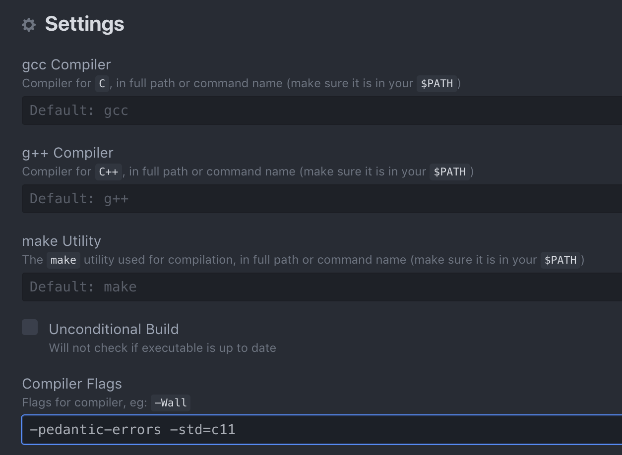
Compilation in C

Slide 52
Hello World in C
Take a look at this simple program in C.
/* this is my first C hello world program */
#include <stdio.h>
int main() {
printf("Hello World!\n");
return 0;
}
helloworld.c
Compare this to the C++ program
// this is my first C++ hello world program
#include <iostream>
using namespace std;
int main() {
cout << “Hello World!” << endl;
return 0;
}

Slide 53
Hello World in C
/* this is my first C hello world program */
#include <stdio.h>
int main() {
printf("Hello World!\n");
return 0;
}
Comments are enclosed in
/* … */
Comments may span multiple lines
Include stdio.h for using standard I/O functions such as printf
Standard output are done via the printf statement
The newline character '\n' is used for the line break.
Try compile the program and check the result.

Slide 54
Adding Two Numbers
addition.c
Standard input is done via the scanf function. "%d" is the format control string which indicates that the input data should be in integer.
&x is the memory location of the variable (x) in which the data should be stored.
This statement essentially reads in an integer and store it to the variable x.
#include <stdio.h>
int main()
{
int x, y, z;
printf("Enter first integer:\n");
scanf("%d", &x);
printf("Enter second integer:\n");
scanf("%d", &y);
z = x + y;
printf("Sum is %d\n", z);
return 0;
}
Screen output
Enter first integer:
32
Enter second integer:
65
Sum is 97
The numbers in blue above are user inputs.
We will talk more about formatted input and output in C in later modules.

Slide 55
Character Handling Functions
Recall (from Module 6) that a character takes up 1 byte of storage space. The values 0-127 stored in a char correspond to a particular character in the ASCII character set. We may also perform arithmetic operations on char as if they are of int data type.
The <ctype.h> header file contains handy functions for character handling. Here are some examples:
int isdigit(int c) | Returns a nonzero (true) value if c is a digit, and 0 (false) otherwise
int isalpha(int c) | Returns a nonzero (true) value if c is a letter, and 0 (false) otherwise
int isalnum(int c) | Returns a nonzero (true) value if c is a digit or a letter, and 0 (false) otherwise
int islower(int c) | Returns a nonzero (true) value if c is a lowercase letter, and 0 (false) otherwise
int isupper(int c) | Returns a nonzero (true) value if c is an uppercase letter, and 0 (false) otherwise
int toupper(int c) | If c is a lowercase letter, returns c as an uppercase letter. Otherwise, returns the argument unchanged.
int tolower(int c) | If c is an uppercase letter, returns c as lowercase letter. Otherwise, returns the argument unchanged.
Reference only: check this for more character handling functions

Slide 56
"%c%s%s" indicates that printf will output a character (%c) followed by two strings (%s) to the standard output.
charfunc.c
#include <stdio.h>
#include <ctype.h>
int main()
{
char a;
a = '7';
printf("%c%s%s\n", a, isdigit(a) ? " is " : " is not ", "a digit" );
a = '$';
printf("%c%s%s\n", a, isdigit(a) ? " is " : " is not ", "a digit" );
a = 'B';
printf("%c%s%s\n", a, isalpha(a) ? " is " : " is not ", "a letter" );
a = 'b';
printf("%c%s%s\n", a, isalpha(a) ? " is " : " is not ", "a letter" );
a = '4';
printf("%c%s%s\n", a, isalpha(a) ? " is " : " is not ", "a letter" );
a = 'Z';
printf("%c%s%s\n", a, islower(a) ? " is " : " is not ", "a lowercase letter" );
a = 'z';
printf("%c%s%s\n", a, isalpha(a) ? " is " : " is not ", "a lowercase letter" );
a = '5';
printf("%c%s%s\n", a, isalpha(a) ? " is " : " is not ", "a lowercase letter" );
a = 'M';
printf("%c%s%s\n", a, islower(a) ? " is " : " is not ", "an uppercase letter" );
a = 'm';
printf("%c%s%s\n", a, isalpha(a) ? " is " : " is not ", "an uppercase letter" );
a = '#';
printf("%c%s%s\n", a, isalpha(a) ? " is " : " is not ", "an uppercase letter" );
return 0;
}
The first character to output is stored in the variable a
The next string to output depends on the value of isdigit(a), if it is true, then " is " is output; otherwise " is not " is output.
The last string to output is "a digit"

Slide 57
Character Handling Functions
Screen output of charfunc.c
7 is a digit
$ is not a digit
B is a letter
b is a letter
4 is not a letter
Z is not a lowercase letter
z is a lowercase letter
5 is not a lowercase letter
M is not an uppercase letter
m is an uppercase letter
# is not an uppercase letter

Slide 58
Character Handling Functions
charconvert.c
#include <stdio.h>
#include <ctype.h>
int main()
{
char a;
a = 'e';
printf("%c converted to uppercase is %c\n", a, toupper(a));
a = 'S';
printf("%c converted to uppercase is %c\n", a, toupper(a));
a = '%';
printf("%c converted to uppercase is %c\n", a, toupper(a));
a = '9';
printf("%c converted to uppercase is %c\n", a, toupper(a));
a = 'w';
printf("%c converted to lowercase is %c\n", a, tolower(a));
a = 'R';
printf("%c converted to lowercase is %c\n", a, tolower(a));
a = '&';
printf("%c converted to lowercase is %c\n", a, tolower(a));
a = '2';
printf("%c converted to lowercase is %c\n", a, tolower(a));
return 0;
}
Screen output
e converted to uppercase is E
S converted to uppercase is S
% converted to uppercase is %
9 converted to uppercase is 9
w converted to lowercase is w
R converted to lowercase is r
& converted to lowercase is &
2 converted to lowercase is 2

Slide 59
Strings in C
Recall from Module 6 that a string can be represented as an array of char (C-Strings), which is ended by a null character ('\0’):
We do not have string objects in C, and C-Strings are the only representation for strings in a C program.
"Hello World!"
A character array of 13 elements
A string of length = 12
'H' | 'e' | 'l' | 'l' | 'o' | ' ' | 'W' | 'o' | 'r' | 'l' | 'd' | '!' | '\0'
the space character
the null character to indicate the end of string
Each element is of type char

Slide 60
String Handling Functions
You may manipulate individual characters in a char array storing a string, or you may make use of some string handling functions.
Let's take a look at some string conversion functions first.
Include <stdlib.h> for using the following functions
int atoi(const char *str) | Converts the string pointed to by str to int
double atof(const char *str) | Converts the string pointed to by str to double
the "const" specifier indicates that the parameter str (i.e., the string input to these functions) will not be modified by the functions
the "*" here means a pointer to the input string (i.e. an address of the memory location where the string is stored). For the time being, just remember that the name of the character array storing the string provides such a pointer. See example next page on the usage.
Reference only: check this for more string handling functions

Slide 61
String Conversion Functions
stringconvert.c
#include <stdio.h>
#include <stdlib.h>
int main()
{
int i;
double d;
long l;
i = atoi("1340");
printf("The string \"1340\" converted to int is %d\n", i);
printf("The converted value minus 111 is %d\n", i-111);
d = atof("23.9");
printf("The string \"23.9\" converted to double is %.3f\n", d);
printf("The converted value divided by 3 is %.3f\n", d / 3);
return 0;
}
the "%.3f" specifier indicates that the parameter printf is to output a floating point number (f) with 3 decimal places (.3)
Screen output
The string "1340" converted to int is 1340
The converted value minus 111 is 1229
The string "23.9" converted to double is 23.900
The converted value divided by 3 is 7.967

Slide 62
String Handling Functions
Include <string.h> for using the following functions
char *strcpy(char *s1, const char *s2) | Copies the string s2 into the array s1
char *strncpy(char * s1, const char *s2, size_t n) | Copies n characters of the string s2 into the array s1
char *strcat(char *s1, const char *s2) | Appends the string s2 into array s1. The first character of s2 overwrites the terminating '\0' character of s1
char *strncat(char *s1, const char *s2, size_t n) | Appends n characters of the string s2 into array s1. The first character of s2 overwrites the terminating '\0' character of s1
int strcmp(const char *s1, const char *s2) | Compares the string s1 to the string s2. Returns 0, less than 0, or great than 0 if s1 is equal to, less than, or greater than s2, in lexicographical order, respectively
size_t strlen(const char *s) | Returns the length of string s (i.e., the number of characters preceding '\0')
Note that C-strings do not support direct assignment, e.g., you CANNOT write char s1[20];
s1 = "abc";
so you need strcpy() to do assignment
Also, comparison of strings using == is not supported, you'll need to use strcmp() for C-strings comparison
This is the same as the unsigned integer type, i.e., the number must be a non-negative number

Slide 63
String Handling Functions
#include <stdio.h>
#include <string.h>
int main()
{
char x[30] = "ENGG1340 computer programming";
char y[30], z[10];
char s1[20] = "Keep calm ";
char s2[20] = "and code ";
char s3[40] = "";
strcpy(y, x);
printf("%s\n%s\n", x, y);
strncpy(z, x, 8);
printf("%s\n%s\n", z, y);
printf("%s\n", s1);
strcat(s1, s2);
printf("%s\n", s1);
strncat(s3, s2, 4);
printf("%s\n", s3);
strcat(s3, s1);
printf("%s\n\n", s3);
printf("%d\n", strcmp(x, y));
printf("%d\n", strcmp(s1, s3));
printf("%d\n\n", strcmp(s1, x));
printf("length of x = %d\n", strlen(x));
return 0;
}
Note that you'll need to make sure that the destination char array for the copy functions is large enough for the resulting string; otherwise, runtime error will occur
Screen output
ENGG1340 computer programming
ENGG1340 computer programming
ENGG1340
ENGG1340 computer programming
Keep calm
Keep calm and code
and
and Keep calm and code
0
-22
6
29
string_manipulation.c

Slide 64
Using C-Strings in C++
You may use C-strings in C++, and to use the character and string handling functions, include the following headers
in C | in C++
#include <ctype.h> | #include <cctype>
#include <stdlib.h> | #include <cstdlib>
#include <string.h> | #include <cstring>
To convert a C++ string to C-string, you may use the .c_str() member function of a string object:
#include <string>
#include <cstring>
int main()
{
string str = "abc";
char s1[10];
strcpy(s1, str.c_str());
cout << s1 << endl;
return 0;
}

Slide 65
Now switching back to C++…
Remember to set your compiler options properly before you proceed.

Slide 66
Recursion
Part III

Slide 67
What are we going to learn?
Recursive definition
Recursive functions in C++
Flow of control in recursive functions
General structure of a recursive function
Examples of recursive functions
Stack overflow problem
Recursion versus iteration

Slide 68
Recursive Definition
Some problems are recursive by nature, i.e., it has a recursive definition which means that the problem can be defined in terms of a smaller version of itself.
Consider the factorial of a nonnegative integer:
Definition 1
0! = 1
n! = n × (n−1) × (n−2) × … × 2 × 1, if n > 0
An iterative definition
Definition 2
0! = 1
n! = n × (n−1)!, if n > 0
A recursive definition

Slide 69
Recursive Definition
How does a recursive definition work?
Base case
Eq. (1):
Eq. (2):
0! = 1
n! = n × (n−1)!, if n > 0
General case
To calculate 3! :
1. Apply Eq. (2) :
3! = 3 × 2!
General case
7. Substitute: 3! = 3 × 2 = 6
2. Apply Eq. (2) :
2! = 2 × 1!
General case
6. Substitute: 2! = 2 × 1 = 2
3. Apply Eq. (2) :
1! = 1 × 0!
General case
5. Substitute: 1! = 1 × 1 = 1
4. Apply Eq. (1) :
0! = 1
Base case

Slide 70
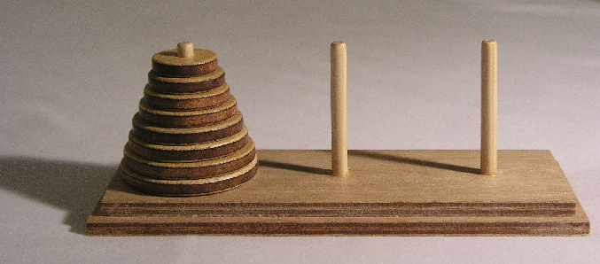
Recursive Definition
Properties for a recursive definition
Must have one (or more) base cases
The general case must be reduced to a base case eventually
The base case terminates the recursion
Some more examples of recursive problems
Fibonacci sequence: 0, 1, 1, 2, 3, 5, 8, 13, 21, 34, …
F_{n} = F_{n-1} + F_{n-2} , F₀ = 0, F₁ = 1
Tower of Hanoi
General case: a number is the sum of its previous two numbers
Image from Wikimedia Commons

Slide 71
Recursive Function
In C/C++, we may write recursive function to implement recursion.
A recursive function is one that contains a call to itself.
int factorial(int num)
{
if (num == 0)
return 1;
else
return num * factorial(num – 1);
}
Base case
General case
Since the argument passed to the functions keeps decrementing by 1, we are certain that the base case will be reached eventually which stops the recursion.
factorial.cpp

Slide 72
Flow of Control
Flow of control is essentially the same as function calls, except that the same function is repeatedly called.
Suppose we call factorial(3):
int factorial(int num)
{
if (num == 0)
return 1;
else
return num * factorial(num – 1);
}
factorial(3)
factorial(3) = 6
num
3
Halts at return 3 * factorial(2);
return 3 * 2
num
2
factorial(2) = 2
factorial(2)
Halts at return 2 * factorial(1);
return 2 * 1
num
1
factorial(1) = 1
factorial(1)
Halts at return 1 * factorial(0);
return 1 * 1
factorial(0)
num
0
factorial(0) = 1
Executes return 1;
return 1

Slide 73
General Structure
The process of calling a function itself recursively can be repeated any number of times.
How to avoid infinite recursion?
General structure for a recursive function definition:
Having one or more recursive calls to itself to accomplish smaller tasks
Having one or more base cases without using recursive calls to terminate the recursion
int factorial(int num)
{
if (num == 0)
return 1;
else
return num * factorial(num – 1);
}
Base case without using recursion
Recursion to handle smaller tasks by making recursive calls

Slide 74
Example: Fibonacci Sequence
Recursive definition for the problem:
F₀ = 0, F₁ = 1
F_{n} = F_{n-1} + F_{n-2} , if n > 1
Base case
The sequence:
0, 1, 1, 2, 3, 5, 8, 13, 21, 34, …
Recursion
int fib(int num)
{
}
Base case without using recursion
if (num < 2)
return ???;
num;
else
return ???;
fib(num-1) + fib(num-2);
fibonacci.cpp
Recursion to handle smaller tasks by making recursive calls

Slide 75
Example: Fibonacci Sequence
Suppose we call
fib(4):
fib(4)
return 3
Hence, fib(4) = 3
num
4
17
return fib(3) + fib(2)
1
return 2
11
return 1
fib(3)
10
fib(2)
16
num
3
num
2
return fib(2) + fib(1)
return fib(1) + fib(0)
2
7
8
9
12
return 1
14
return 0
return 1
return 1
fib(1)
13
fib(0)
fib(2)
fib(1)
15
num
2
num
1
num
1
num
0
return fib(1) + fib(0)
return num
return num
return num
3
return 1
5
return 0
fib(1)
4
fib(0)
6
num
1
num
0
return num
return num

Slide 76
Example: Greatest Common Divisor
Euclidean algorithm
E.g., gcd of 48 and 18:
2
1
2
18
48
36
12
18
12
6
12
12
gcd = 6
12
18÷12
6
12÷6
0
A recursive definition
int gcd(int x, int y)
{
}
gcd(x, y)
x, if y = 0
if (y == 0)
return ???;
=
x;
gcd( y, remainder of x / y ) ,
otherwise
else
return ???;
gcd(y, x%y);
gcd.cpp

Slide 77
Example: Palindrome
Recall that a palindrome is a word that reads the same forward and backward, e.g., level, noon, racecar
Recursive algorithm
r | a | c | e | c | a | r
To check if a string s[0..n–1] is a palindrome,
if n < 2, s is a palindrome
otherwise, s is a palindrome if and only if s[0] is the same as s[n-1] and s[1..n-2] is a palindrome
palindrome_recursive.cpp
bool is_palindrome( string s )
{
}
if (s.length() < 2)
return ???;
true;
else
return ???;
(s[0] == s[s.length()-1])
&& is_palindrome(s.substr(1,s.length()-2));

Slide 78
Example: Tower of Hanoi
The Tower of Hanoi is a mathematical game, consisting of three rods and disks of different sizes which can slide onto any rod.
The puzzle starts with the disks neatly stacked in order of size on one rod, the smallest at the top, thus making a conical shape.
Objectives: To move the entire stack to another rod.
Rules:
Only one disk may be moved at a time
The removed disk must be placed on one of the rods
No disk may be placed on top of a smaller disk
Image from Wikimedia Commons

Slide 79
Tower of Hanoi
Suppose the task is to move the stack from rod A to rod C
What if the initial stack contains 1 disk only?
Move from A to C
A
B
C
A
B
C
Done! 1 step
What if the initial stack contains 2 disks?
Move from A to B
A
B
C
A
B
C
Move from A to C
A
B
C
Move from B to C
A
B
C
Done! 3 steps

Slide 80
Example: Tower of Hanoi
What if the initial stack contains 3 disks?
1
Move from A to C
A
B
C
A
B
C
2
Move from A to B
A
B
C
3
Move from C to B
A
B
C
4
Move from A to C
A
B
C

Slide 81
Example: Tower of Hanoi
5
Move from B to A
A
B
C
A
B
C
6
Move from B to C
A
B
C
7
Move from A to C
A
B
C
Done! 7 steps
What if the initial stack contains 64 disks???
Look at the example for moving 3 disks:
Steps 1 to 3 essentially move a stack of 2 disks from A to B
Step 4 moves a disk (the lowest of the initial stack) from A to C
Steps 5 to 7 essentially move a stack of 2 disks from B to C
A recursive algorithm!

Slide 82
Example: Tower of Hanoi
Recursive algorithm
To move a stack of n disks from rod A to rod C, n >= 1
Move the top n – 1 disks from A to B, using C as an intermediate rod
Move the remaining 1 disk from A to C
Move the top n – 1 disks from B to C, using A as an intermediate rod
No. of disks to move
Source rod
Destination rod
Intermediate rod
void move(int n, char src, char des, char tmp)
{
}
if (n == 1)
cout << "Move disk from " << src << " to " << des << endl;
else {
}
move( n-1, src, tmp, des);
move( 1, src, des, tmp);
move( n-1, tmp, des, src);
hanoi.cpp

Slide 83
Example: Tower of Hanoi
How many steps does it take to move 64 disks?
Hence, it takes
2⁶⁴- 1 ≈ 1.6 × 10¹⁹ steps to move 64 disks
No. of steps to move n disks
T(n) = 2 T(n – 1) + 1
If it takes 1 second to move a disk physically by hand, it would take 5 × 10¹¹ years to finish.
= 2 [ 2 T(n – 2) + 1 ] + 1
= 2² T(n – 2) + 2 + 1
= 2² [ 2 T(n – 3) + 1 ] + 2 + 1
= 2³ T(n – 3) + 2² + 2 + 1
= …
= 2^{n – 1} T(n – (n – 1)) + 2^{n – 2} + … + 2² + 2 + 1
= 2^{n – 1} T(1) + 2^{n – 2} + … + 2² + 2 + 1
= 2^{n – 1} + 2^{n – 2} + … + 2² + 2 + 1
= 2^{n} – 1
If a computer can generate 10⁹ moves per second, it still takes 500 years to generate all the moves!

Slide 84
Stack Overflow
Each function call entails additional memory space (function call stack).
There is always some limit to the memory size.
If there is excessively long chain of recursive call, e.g., infinite recursion, stack overflow error may occur
Try the Tower of Hanoi program and see what’s the largest n that will crash your machine ☺

Slide 85
Recursion vs Iteration
Recursion is NOT absolutely necessary.
Any task that can be accomplished using recursion can also be done in some other way without using recursion.
The non-recursive version of a function typically uses a loop of some sort in place of recursion, hence often being referred to as iterative version.
A recursively written function will usually run slower and use more storage than an equivalent iterative version (due to extra work in memory management for function calls (aka stack management).
Nonetheless, using recursion can sometimes make the job of programming easier and produce code that is easier to understand.

Slide 86
Recursion vs Iteration
Recursive example:
Iterative example:
int binary_search(int A[], int lb, int ub, int value)
{
if (lb > ub)
return -1;
else
{
int i = (lb + ub) / 2;
if (A[i] == value)
return i;
else if (A[i] > value)
return binary_search(A, lb, i - 1, value);
else
return binary_search(A, i + 1, ub, value);
}
}
int binary_search(int A[], int size, int value)
{
int lb = 0, ub = size - 1;
while (lb <= ub)
{
int i = (lb + ub) / 2;
if (A[i] == value)
return i;
else if (A[i] > value)
ub = i - 1;
else
lb = i + 1;
}
return -1;
}
binary_search.cpp

Slide 87
Sum of natural numbers
Tutorial Problems - Recursion

Slide 88
Sum of Natural Numbers
Write a program that calculates the sum of the first n natural numbers, i.e., 1 + 2 + … + n.
Create a new file and save it as sum.cpp
Write a main function that
ask a user to input a positive integer n
call a function sum(n) to calculate the sum
output the result
Write a sum() function (see also next slide) that
takes an integer n as input parameter
return the result of 1 + 2 + … + n
Sample output (user input in orange):
sum_complete.cpp provides the completed version of this tutorial problem. You may compile and run it to see the expected results first.
Enter a positive integer: 5 Sum of first 5 natural numbers = 15

Slide 89
Sum of Natural Numbers
First version of sum() – iterative version
Write a sum() function so that it makes use of a loop to calculate the sum
Run and test your program
Second version of sum() – recursive version
Write a sum() function which makes use of recursion to calculate the sum
What is the base case? What is the general case?
Run and test your program
Idea: 1+2+…+n = (1+2+…+n-1) + n
This is sum(n)
So what is this?
Go to see Hints if you want the answer to these two questions

Slide 90
Largest element in an array
Tutorial Problems - Recursion

Slide 91
Largest Element in an Array
Write a program to find the largest element in an array
Open largest_element_incomplete.cpp
Study the main function. It
generates a set of random positive numbers in an array
outputs the numbers to the screen
determines the largest element in the array by calling largest()
outputs the largest element
largest_element.cpp provides the complete version of this tutorial problem.

Slide 92
Largest Element in an Array
Write the largest_element() function that uses a loop to determine the largest element in an array
First determine the function prototype. Look at how it is called in main(). What should be the input parameters? What should be the return value?
Finish the function body. Compile and run the program.
Write the largest_element() function that uses recursion to determine the largest element in an array
What is the base case? What is the general case?
A: 82 is the largest of the first 6 elements
23 | 14 | 67 | 45 | 3 | 82
How to determine A using the results of B?
B: 67 is the largest of the first 5 elements
Go to see Hints if you want the answer to these two questions

Slide 93
Reversing a string
Tutorial Problems - Recursion

Slide 94
Reversing a String
Write a program to reverse an input string.
Open string_reverse_incomplete.cpp
Study the main function. It
asks the user to input a string
reverse the string by calling reverse()
print out the reversed string
Write the reverse() function that uses a loop to reverse an input string
First determine the function prototype. Look at how it is called in main(). What should be the input parameters? What should be the return value?
Finish the function body. Compile and run the program.
string_reverse.cpp provides the complete version of this tutorial problem.

Slide 95
Reversing a String
Write the reverse() function that uses recursion to reverse an input string
What is the base case? What is the general case?
A
p | r | o | g | r | a | m | m | i | n | g
B
reverse of A
g | n | i | m | m | a | r | g | o | r | p
reverse of B
How is reverse of A and reverse of B related?
Go to see Hints if you want the answer to these two questions

Slide 96
Hints
Note that these are only suggestions.
You may come up with other solutions that work as well!
Sum of Natural Numbers
Largest Element in an Array
Reversing a String
sum = 1, if n = 1
sum(n) = sum(n–1) + n, if n > 1
largest(array[0..n–1]) = –1, if n < 1
largest(array[0..n–1]) = max(largest(array[0..n–2]), array[n–1]) , otherwise
reverse(s[0..n–1]) = s, if length of s = 0,
reverse(s[0..n–1]) = s[n–1] + reverse(s[0..n–2]), otherwise

Slide 97
Problems

Slide 98
Problem 1
Write a program that determines the length of a string by using for loop. DO NOT use any functions provided by <string>.

Slide 99
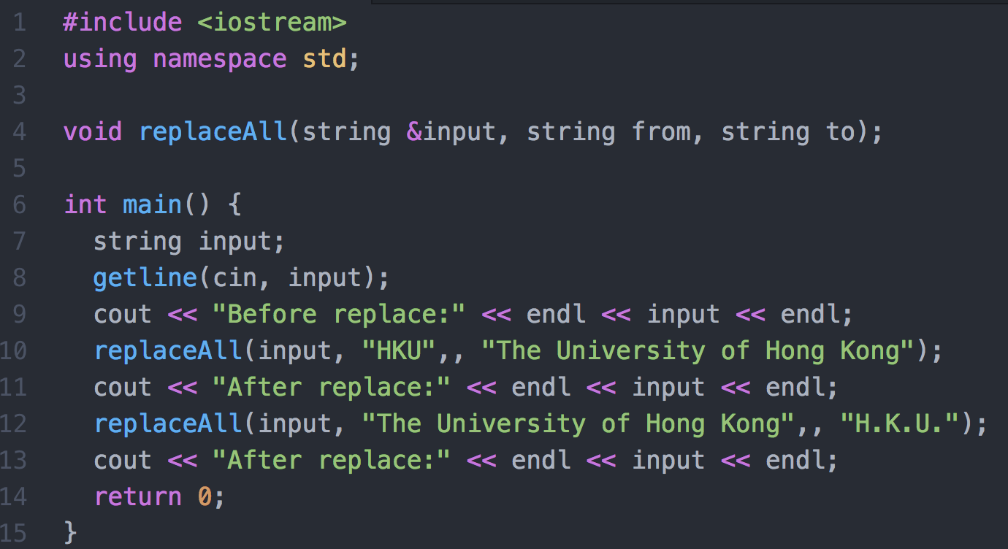
Problem 2
Your task is to implement the replaceAll function so that it will update the string input by replacing all occurrences of from by the string in to. Here is a sample input (underlined) and output of the program:
I study at HKU; I love HKU!
Before replace:
I study at HKU; I love HKU!
After replace:
I study at The University of Hong Kong; I love The University of Hong Kong!
After replace:
I study at H.K.U.; I love H.K.U.!

Slide 100
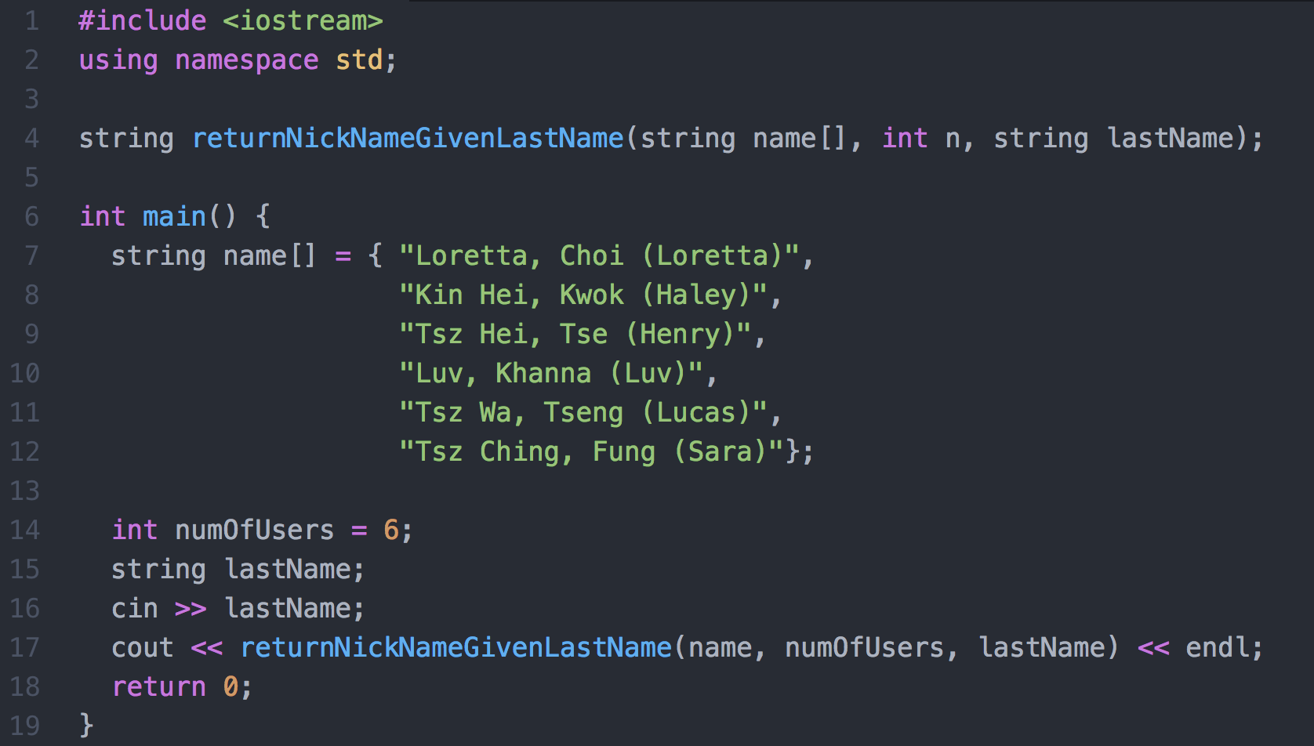
Problem 3
Consider the following program:

Slide 101
Problem 3
The function returnNickNameGivenLastName will search in the string array name for the string lastName of a user and returns the nickname of the matched user.
Each slot of the name[] array stores the name of a user. It uses the following format: [First name][comma][space][Last name][space][open bracket][Nickname][close bracket]
Note that the second input parameter of the function is an integer denoting the number of users (i.e., number of slots in the name[] array).
The function returns a string, which is the nickname of the matched user (you may assume that there is at most one match).
The function returns the string "Not found!" if no match is found. Here is a sample input (underlined) and output of the program:
Choi Loretta

Slide 102
CHALLENGES
Optional.
For those who would like to challenge yourselves. Even for those of you who are beginners in C++ programming, it’s highly recommended for you to take a look at these problems and try to tackle them as well.
You are welcome to discuss these problems in the Moodle forum.

Slide 103
Challenge 1
Write a little library system for storing and searching books with using a text file. The data should include name, author, call number and subject. No restriction on output format.
You may start with the following struct definition, function prototypes and main function design:

Slide 104
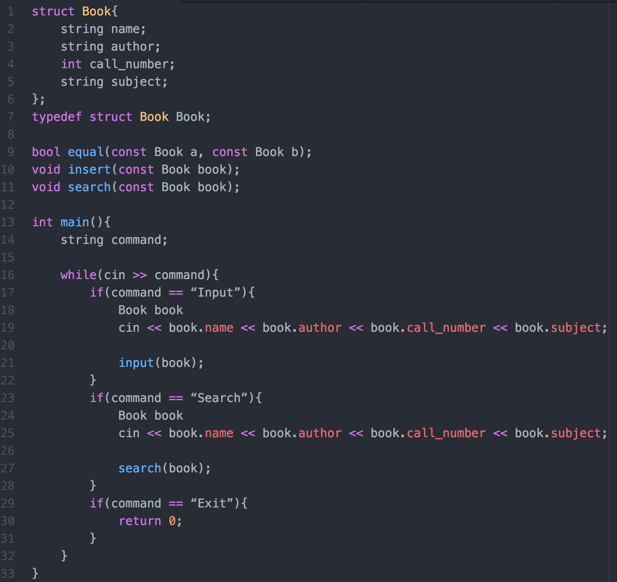
Challenge 1

Slide 105
Challenge 2
This question is on file I/O and string manipulation.
Write a program to read a file and report the number of occurrences of each word in the file. Your program will not distinguish between upper- and lower-case words. E.g., “hello”, “Hello”, “HELLO” are the same. The words must be output in lowercase and sorted in ascending order of their frequencies. Words with same frequency are ordered lexicographically.
Example:
Contents of input file: Hello, where are you going to? Are you going to school to … say hello?
Your program output: say 1 school 1 where 1 are 2 going 2 hello 2 you 2 to 3
Hint: By including <cctype> you can use the function ispunct() to test whether a character is a punctuation or not.

